Slide 1
FIN 580 Project Presentation Comparing Ridge Regression Models – Ridge Regression, Bayesian Ridge Regression and Kernel Ridge Regression
Yaojun Yu
Emanuel Scoullos
May 2017

Slide 2
Agenda
Data Description & Performance Measurement
Introduction to Models Studied
Research Model 1: Ridge Regression Model
Research Model 2: Bayesian Ridge Regression Model
Research Model 3: Kernel Ridge Regression Model
Logic Flow of the Project
Results of Prediction Performance
Benchmark Model 1: PastAsPresent Model
Benchmark Model 2: Linear Regression Model
Research Model 1: Ridge Regression Model
Research Model 2: Bayesian Ridge Regression Model
Research Model 3: Kernel Ridge Regression Model
Further Study

Slide 3
Data Description & Cleaning
We assumed that a day starts from 4:05 pm and ends at 4:00 pm on the next calendar day.
We assumed that the number of trading days in a year to be 252.

Slide 4
Features of Data – Daily Volatility

Slide 5
Features of Data – Daily Volatility & log Volatility
Volatility:
heavier tails than a normal distribution
Log Volatility:
thinner tails than a normal distribution

Slide 6
Features of Data – Daily Volatility & log Volatility: highly correlated

Slide 7
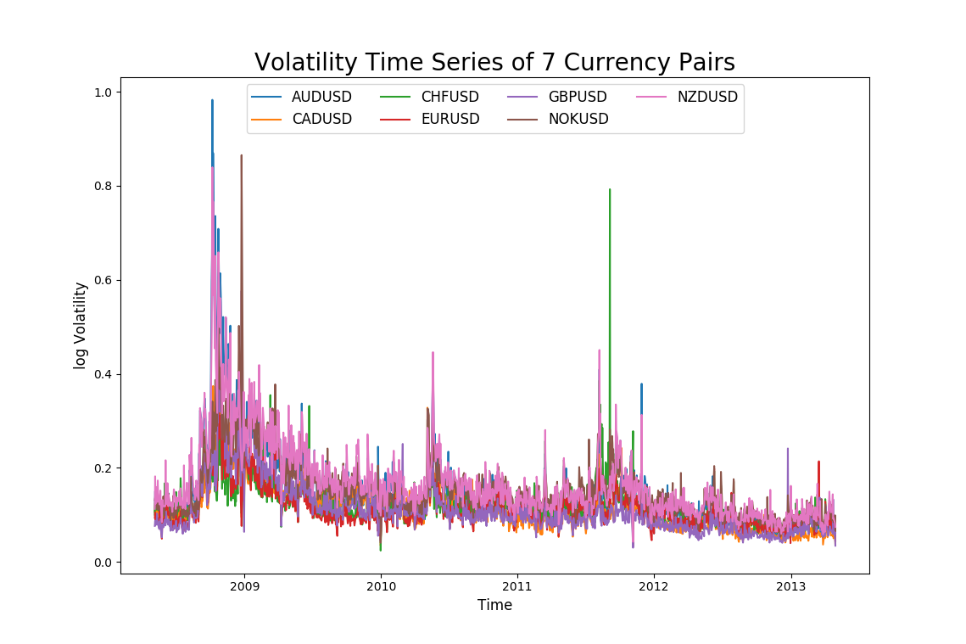
Features of Data Daily Volatility Time Series of 7 Currency Pairs

Slide 8
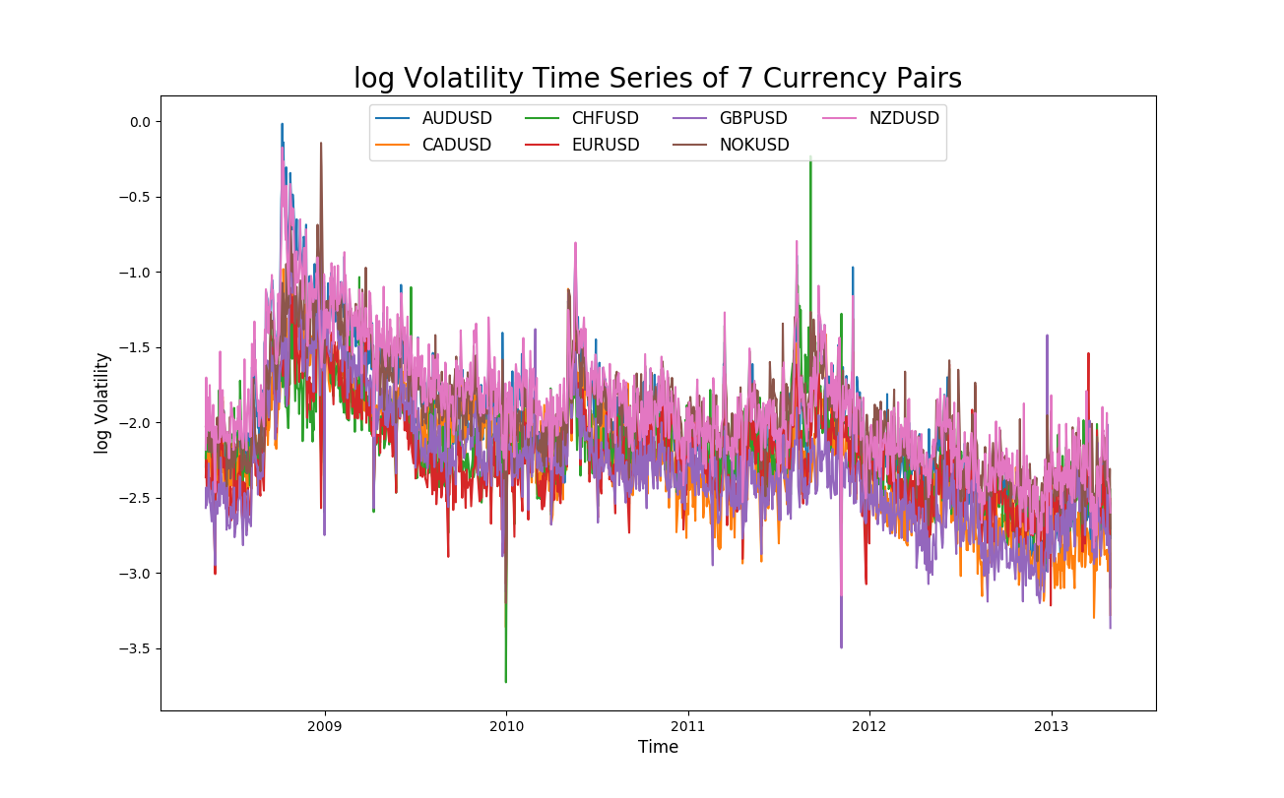
Features of Data Daily log Volatility Time Series of 7 Currency Pairs

Slide 9
Daily Volatility vs. Daily log Volatility
Similar patterns across 7 currency pairs:
Daily volatility: log-normally distributed (approx.)
Daily log volatility: normally distributed (approx.)
We used log volatility to fit all the models studied
Also to avoid predicting negative volatility in the models studied

Slide 10
Training & Test Samples
Training sample:
the first 3.5 years (until October 31st 2011)
Around 910 data
Test sample:
the last 1.5 years (since November 1st 2011)
Around 390 data

Slide 11
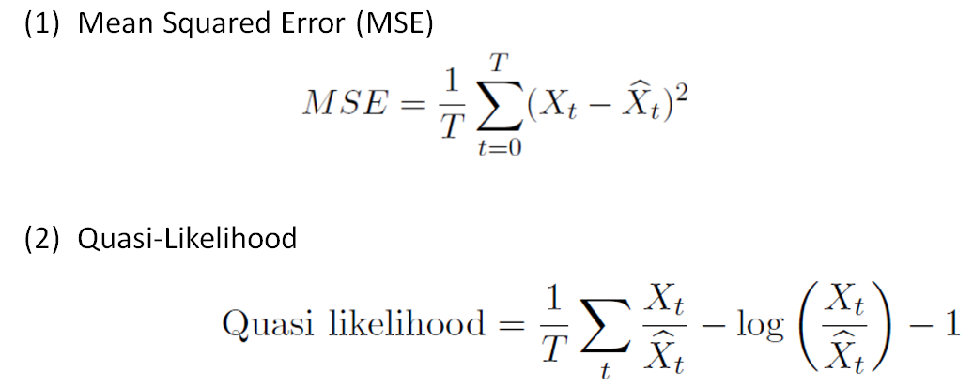
Performance Measurement

Slide 12
Agenda
Data Description & Performance Measurement
Introduction to Models Studied
Research Model 1: Ridge Regression Model
Research Model 2: Bayesian Ridge Regression Model
Research Model 3: Kernel Ridge Regression Model
Logic Flow of the Project
Results of Prediction Performance
Benchmark Model 1: PastAsPresent Model
Benchmark Model 2: Linear Regression Model
Research Model 1: Ridge Regression Model
Research Model 2: Bayesian Ridge Regression Model
Research Model 3: Kernel Ridge Regression Model
Further Study

Slide 13
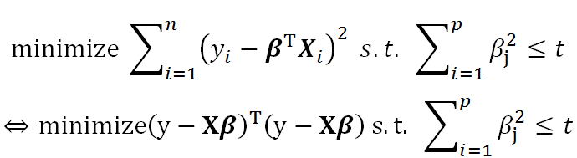
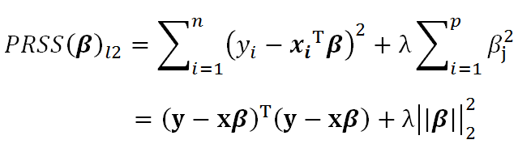
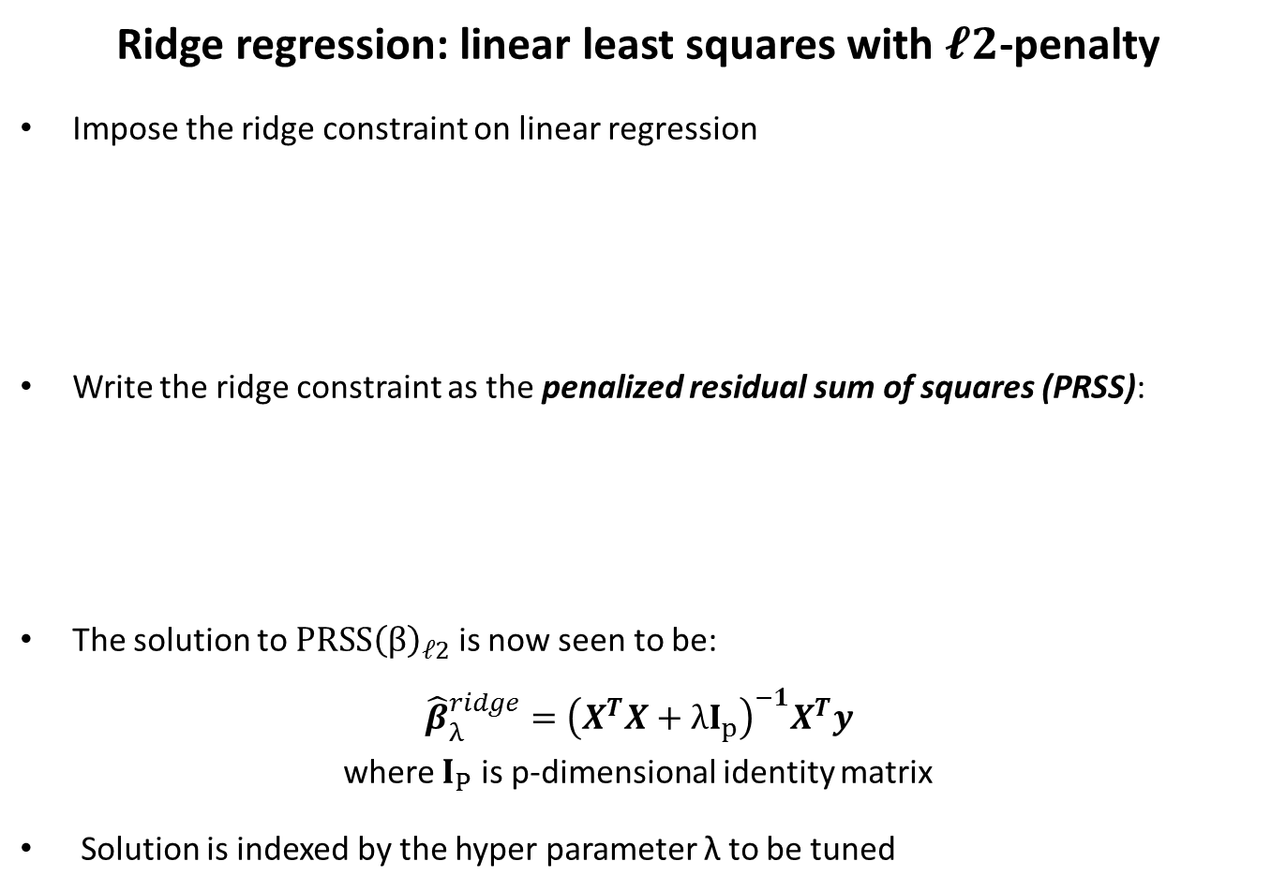
Research Model 1: Ridge Regression Model
Ridge regression: linear least squares with $𝓵2$-penalty
Impose the ridge constraint on linear regression
Write the ridge constraint as the penalized residual sum of squares (PRSS):
The solution to $PRSS{\left(β\right)}_{𝓁2}$ is now seen to be:
$${\hat{β}}_{λ}^{ridge}={\left(X^{T}X+λI_{p}\right)}^{−1}X^{T}y$$
where $I_{P}$ is p-dimensional identity matrix
Solution is indexed by the hyper parameter λ to be tuned

Slide 14
Agenda
Data Description & Performance Measurement
Introduction to Models Studied
Research Model 1: Ridge Regression Model
Research Model 2: Bayesian Ridge Regression Model
Research Model 3: Kernel Ridge Regression Model
Logic Flow of the Project
Results of Prediction Performance
Benchmark Model 1: PastAsPresent Model
Benchmark Model 2: Linear Regression Model
Research Model 1: Ridge Regression Model
Research Model 2: Bayesian Ridge Regression Model
Research Model 3: Kernel Ridge Regression Model
Further Study

Slide 15
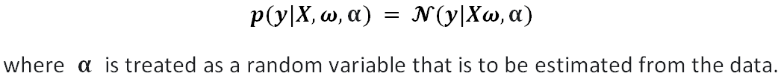
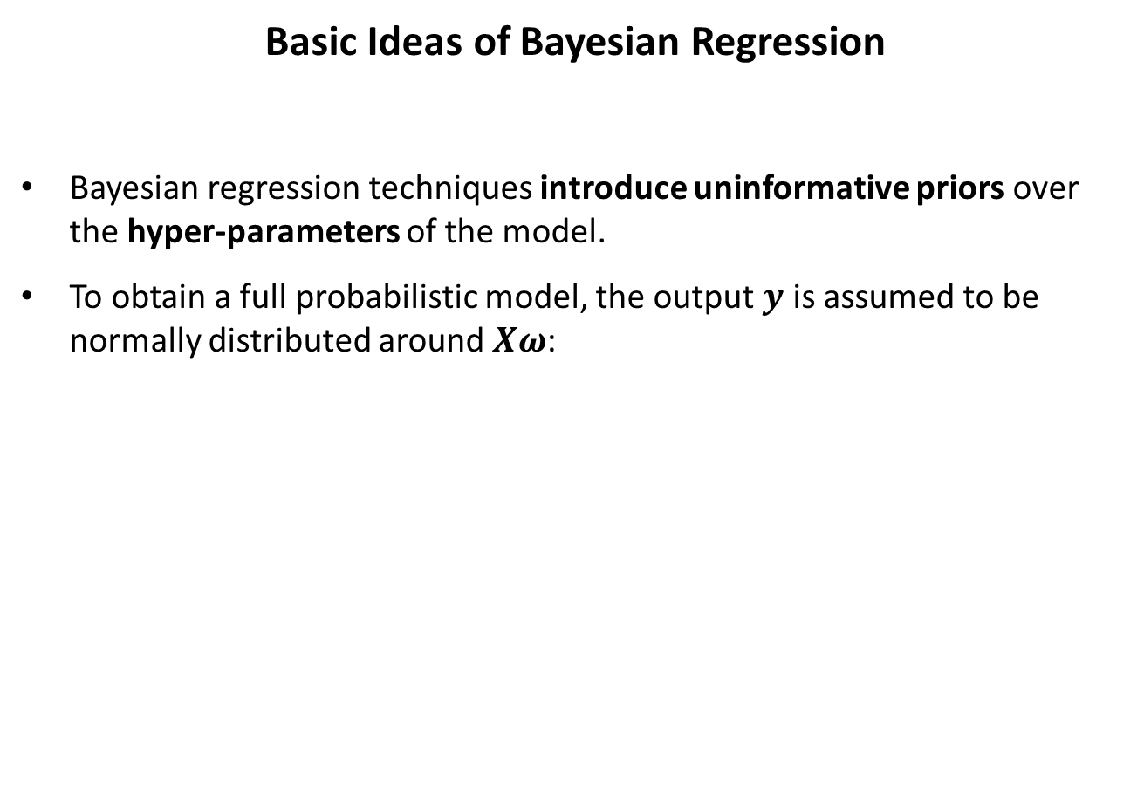
Research Model 2: Bayesian Ridge Regression Model
Basic Ideas of Bayesian Regression
Bayesian regression techniques introduce uninformative priors over the hyper-parameters of the model.
To obtain a full probabilistic model, the output $y$ is assumed to be normally distributed around$Xω$:

Slide 16
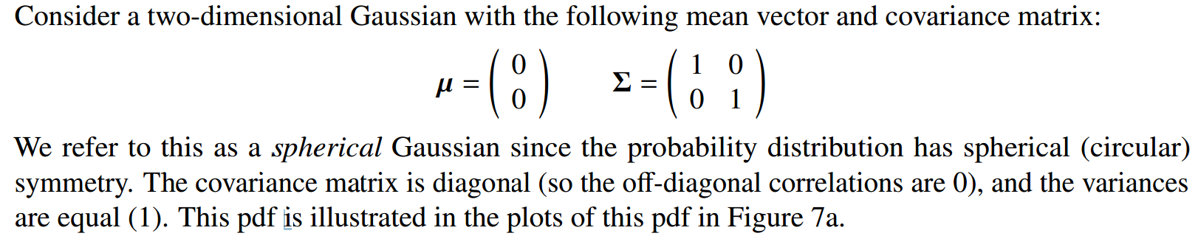
Research Model 2: Bayesian Ridge Regression Model
Basic Ideas of Bayesian Ridge Regression
Spherical Gaussian

Slide 17
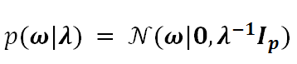
Research Model 2: Bayesian Ridge Regression Model
Basic Ideas of Bayesian Ridge Regression
The prior for the parameter of Bayesian Ridge Regression is given by a spherical Gaussian:
Bayesian Ridge Regression is more robust to ill-posed problem.
Compared with the OLS estimator, the coefficient weights of Bayesian ridge regression are slightly shifted toward zeros, which stabilizes them.
The estimation of the model is done by iteratively maximizing the marginal log-likelihood of the observations.

Slide 18
Agenda
Data Description & Performance Measurement
Introduction to Models Studied
Research Model 1: Ridge Regression Model
Research Model 2: Bayesian Ridge Regression Model
Research Model 3: Kernel Ridge Regression Model
Logic Flow of the Project
Results of Prediction Performance
Benchmark Model 1: PastAsPresent Model
Benchmark Model 2: Linear Regression Model
Research Model 1: Ridge Regression Model
Research Model 2: Bayesian Ridge Regression Model
Research Model 3: Kernel Ridge Regression Model
Further Study

Slide 19
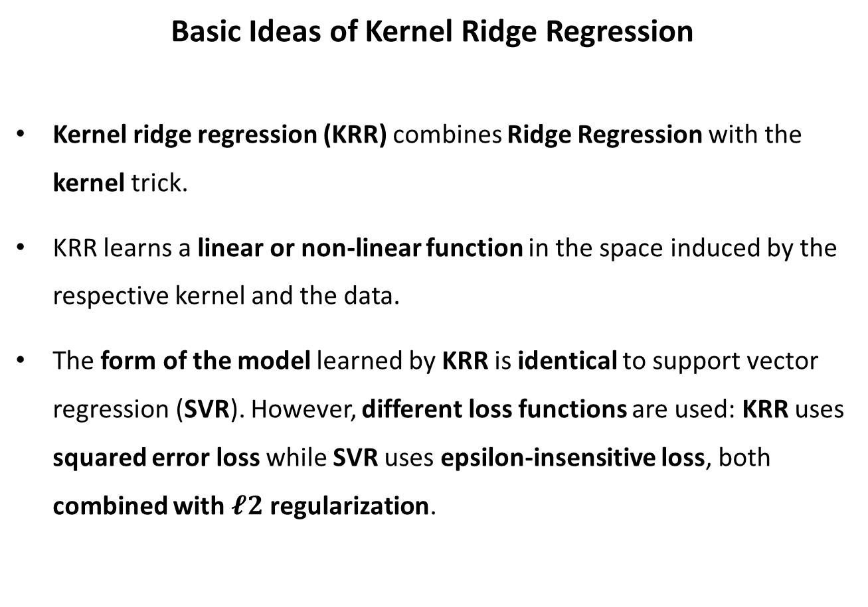
Research Model 3: Kernel Ridge Regression Model
Basic Ideas of Kernel Ridge Regression
Kernel ridge regression (KRR) combines Ridge Regression with the kernel trick.
KRR learns a linear or non-linear function in the space induced by the respective kernel and the data.
The form of the model learned by KRR is identical to support vector regression (SVR). However, different loss functions are used: KRR uses squared error loss while SVR uses epsilon-insensitive loss, both combined with $𝓵2$ regularization.

Slide 20
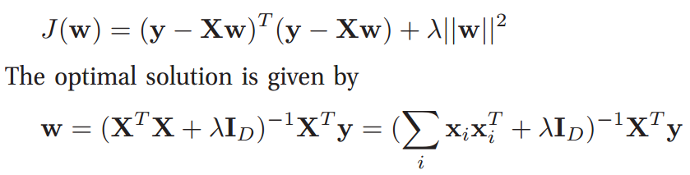
Research Model 3: Kernel Ridge Regression Model
Basic Ideas of Kernel Ridge Regression
The primal problem

Slide 21
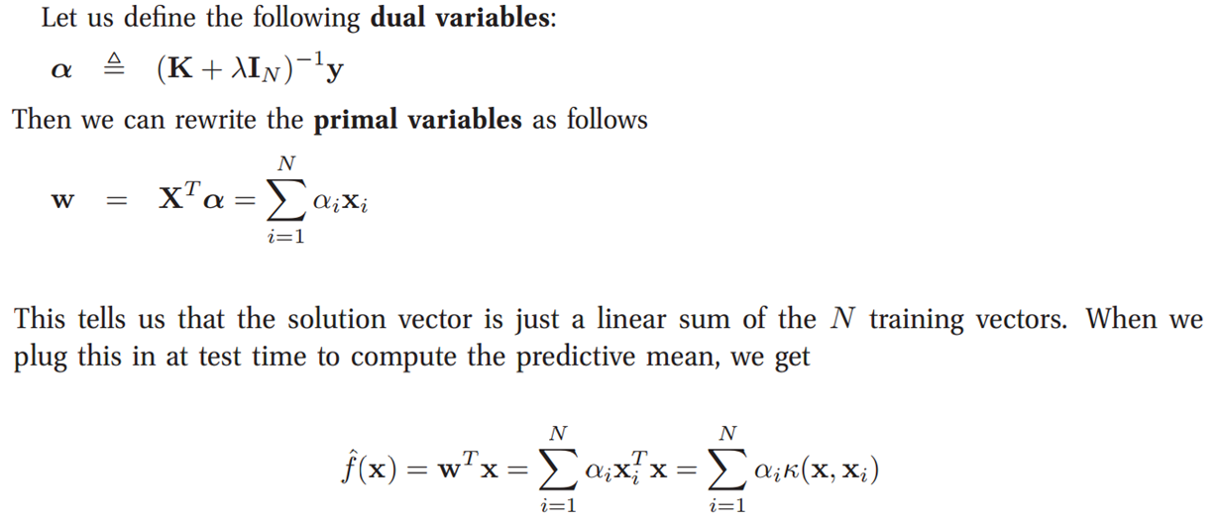
Research Model 3: Kernel Ridge Regression Model
Basic Ideas of Kernel Ridge Regression
The dual problem

Slide 22
Agenda
Data Description & Performance Measurement
Introduction to Models Studied
Research Model 1: Ridge Regression Model
Research Model 2: Bayesian Ridge Regression Model
Research Model 3: Kernel Ridge Regression Model
Logic Flow of the Project
Results of Prediction Performance
Benchmark Model 1: PastAsPresent Model
Benchmark Model 2: Linear Regression Model
Research Model 1: Ridge Regression Model
Research Model 2: Bayesian Ridge Regression Model
Research Model 3: Kernel Ridge Regression Model
Further Study

Slide 23
Logic Flow of the Project
(a) PastAsPresent
Benchmark model 1
(b) linear regression
Benchmark model 2
To be compared with (a): PastAsPresent
(c) ridge regression
To be compared with (a): PastAsPresent & (b): linear regression
(d) Bayesian Ridge Regression
To be compared with (a): PastAsPresent, (b): linear regression & (c) ridge regression
(e) Kernel Ridge Regression
To be compared with (a): PastAsPresent, (b): linear regression & (c) ridge regression

Slide 24
Agenda
Data Description & Performance Measurement
Introduction to Models Studied
Research Model 1: Ridge Regression Model
Research Model 2: Bayesian Ridge Regression Model
Research Model 3: Kernel Ridge Regression Model
Logic Flow of the Project
Results of Prediction Performance
Benchmark Model 1: PastAsPresent Model
Benchmark Model 2: Linear Regression Model
Research Model 1: Ridge Regression Model
Research Model 2: Bayesian Ridge Regression Model
Research Model 3: Kernel Ridge Regression Model
Further Study

Slide 25
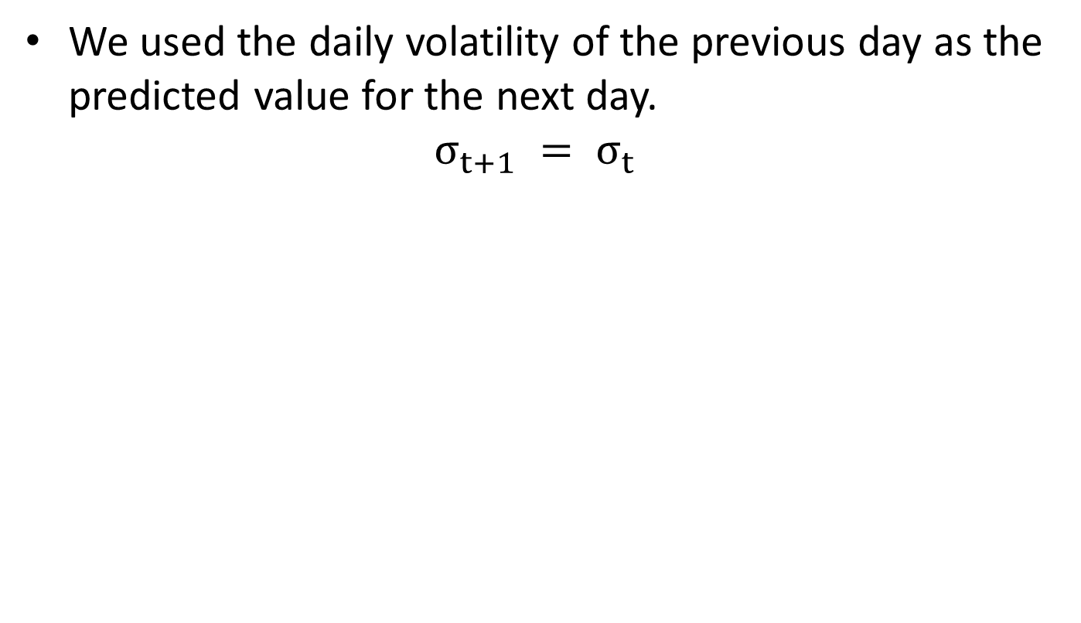
(a) Benchmark Model 1: “Past As Present” Model
We used the daily volatility of the previous day as the predicted value for the next day.
$$σ_{t+1} = σ_{t}$$

Slide 26
Agenda
Data Description & Performance Measurement
Introduction to Models Studied
Research Model 1: Ridge Regression Model
Research Model 2: Bayesian Ridge Regression Model
Research Model 3: Kernel Ridge Regression Model
Logic Flow of the Project
Results of Prediction Performance
Benchmark Model 1: PastAsPresent Model
Benchmark Model 2: Linear Regression Model
Research Model 1: Ridge Regression Model
Research Model 2: Bayesian Ridge Regression Model
Research Model 3: Kernel Ridge Regression Model
Further Study

Slide 27
(b) Benchmark Model 2: Linear Regression Model (with # regressors n optimized)
Data used to fit the
first model in the
training sample
The first prediction
made in the
training sample
Data used to fit the
first model in the
test sample
The first prediction
made in the
test sample
300
301
T1
T1+1
T2
T₁ is the last datum in the training sample
T₁+1 is the first datum in the test sample
Skip the first 300 data
Training Sample
(first 3.5 years)
Test Sample
(last 1.5 years)
Pick the optimal n*
Test using the optimal n*

Slide 28
(b) Benchmark Model 2: Linear Regression Model —— Prediction Performance in the Test Sample
Why did we choose warmup = 300?
Though the optimal n* could vary a lot for different warmup periods, the sum of MSE/QL in the test sample did not vary much for different warm-up periods.
Warmup=300 gave the lowest sum of MSE/QL in the test sample.
Sample size of training sample ~ 910
Thus, we chose warmup=300 for all models for comparison purpose.

Slide 29
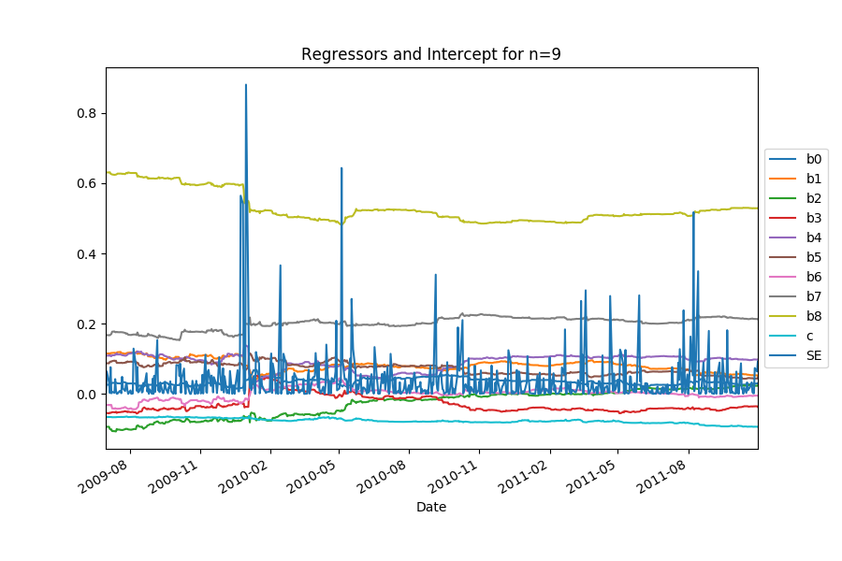
(b) Benchmark Model 2: Linear Regression Model Stability of Coefficients (of Best Fitted Model) in the Training Sample
Observation:
For each currency pair, coefficients of the best fitted model (producing the lowest MSE) in the training sample are quite stable over time
During the period when SE is higher, the value of coefficients often have larger changes
AUDUSD

Slide 30
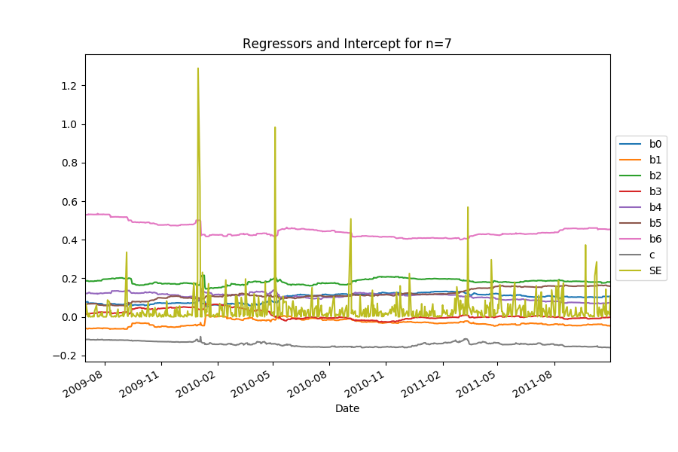
(b) Benchmark Model 2: Linear Regression Model Stability of Coefficients (of Best Fitted Model) in the Training Sample
CADUSD

Slide 31
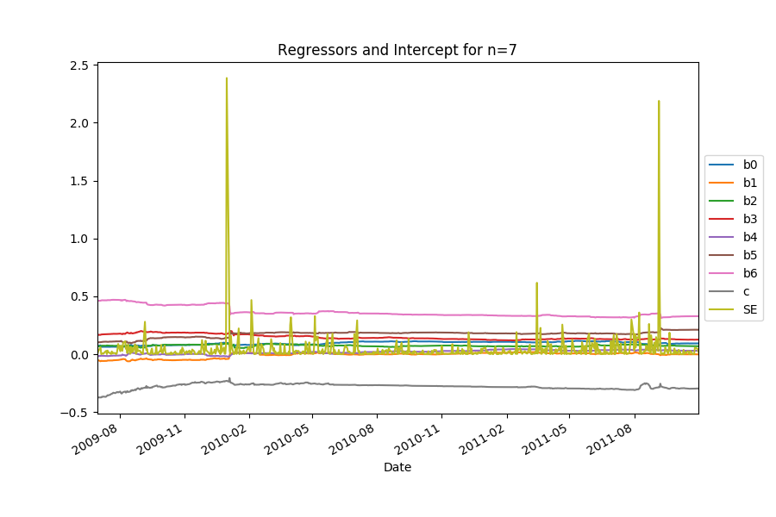
(b) Benchmark Model 2: Linear Regression Model Stability of Coefficients (of Best Fitted Model) in the Training Sample
CFHUSD

Slide 32
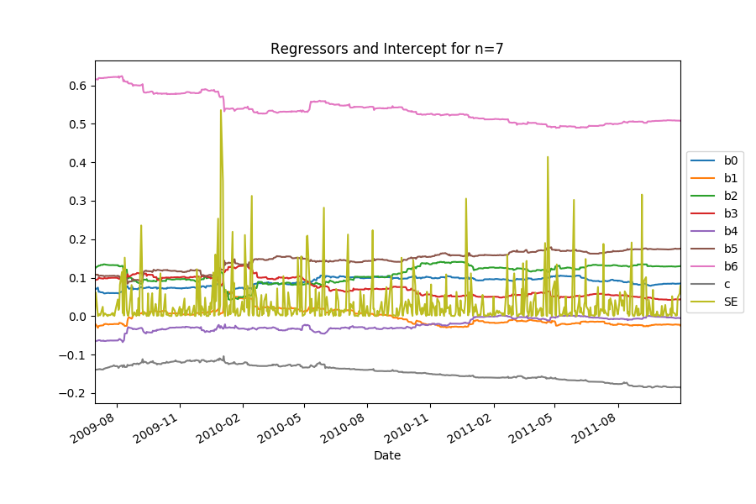
(b) Benchmark Model 2: Linear Regression Model Stability of Coefficients (of Best Fitted Model) in the Training Sample
EURUSD

Slide 33
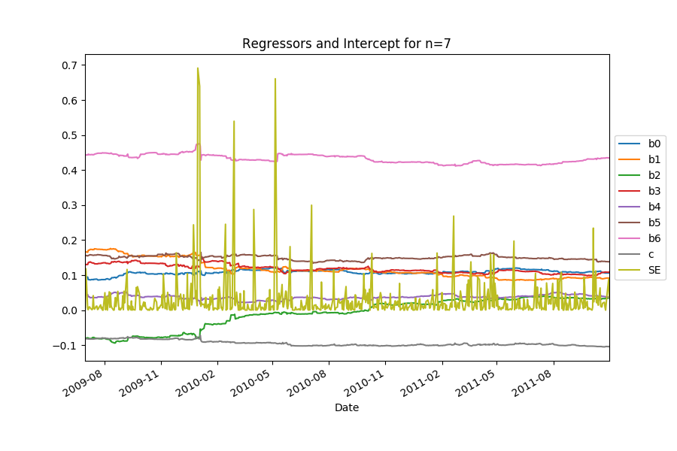
(b) Benchmark Model 2: Linear Regression Model Stability of Coefficients (of Best Fitted Model) in the Training Sample
GBPUSD

Slide 34
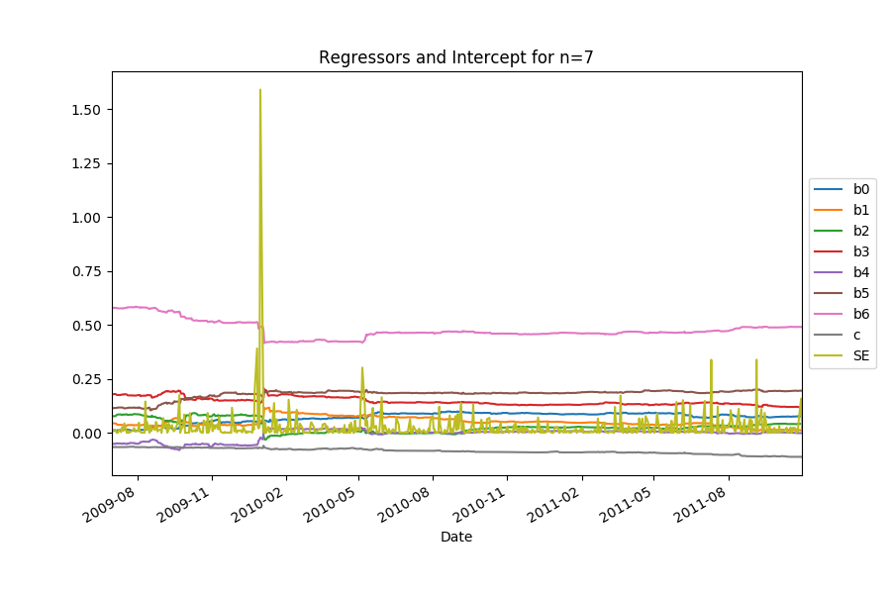
(b) Benchmark Model 2: Linear Regression Model Stability of Coefficients (of Best Fitted Model) in the Training Sample
NOKUSD

Slide 35
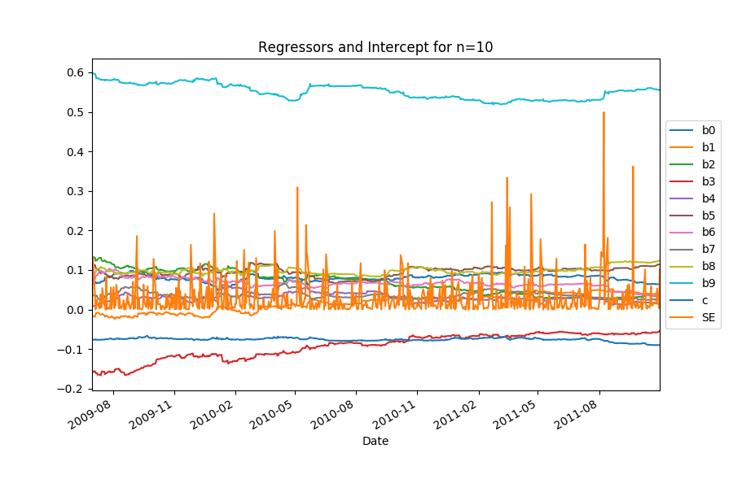
(b) Benchmark Model 2: Linear Regression Model Stability of Coefficients (of Best Fitted Model) in the Training Sample
NZDUSD

Slide 36
(b) Benchmark Model 2: Linear Regression Model vs. Benchmark Model 1: “Past As Present” Model
Observation:
Optimal n for all currency pairs are pretty large
We may consider a simpler model with less number of regressors

Slide 37
(b) Benchmark Model 2: Linear Regression Model What if n = 3 for all currency pairs?
Observation:
Decreasing the number of optimal parameters does not improve prediction performance in terms of sum of MSE & sum of QL in the test sample.
Degree of Outperformance
(different optimal n*
vs. n=3 for all):
Sum of MSE: 10.56%
Sum of QL: 9.45%
A lot? Maybe…

Slide 38
(b) Benchmark Model 2: Linear Regression Model What if n = 5 for all currency pairs?
Why choosing n = 5?
Observation:
Degree of Outperformance
(different optimal n*
vs. n=5 for all):
Pretty small
Sum of MSE: 1.69%
Sum of QL: 1.30%
Thus,
for linear regression, we may want to use n=5 for all currency pairs
- Consistency across all currency pairs.

Slide 39
(b) Benchmark Model 2: Linear Regression Model Summary (Linear Regression vs. PastAsPresent)
Observation:
Linear regression model (with n=5) seems to be the most suitable model in terms of sum of MSE, sum of QL and the level of model complexity

Slide 40
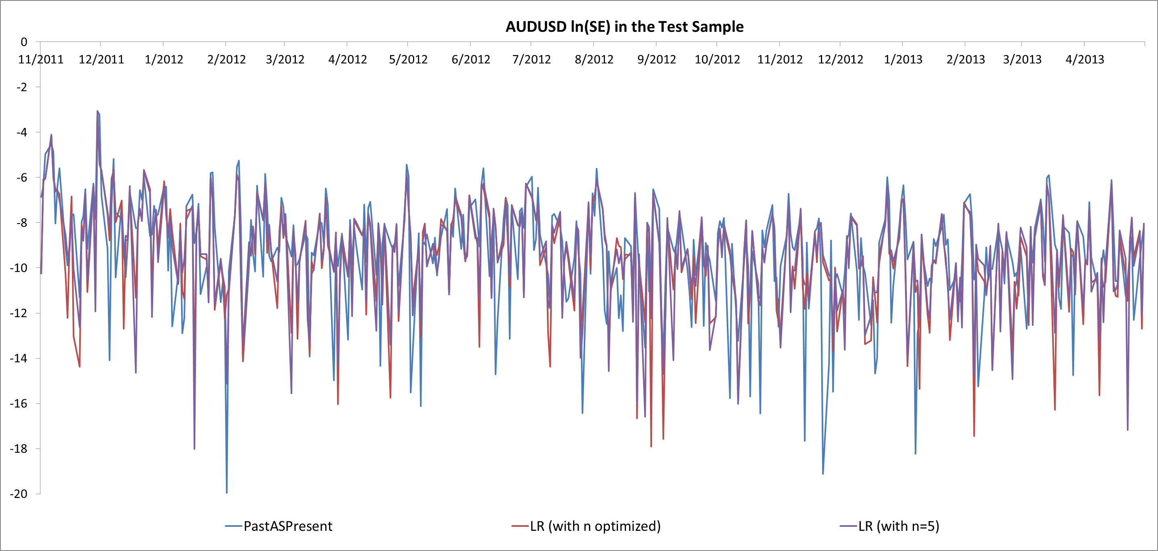
(b) Benchmark Model 2: Linear Regression Model Summary (Linear Regression vs. PastAsPresent)

Slide 41
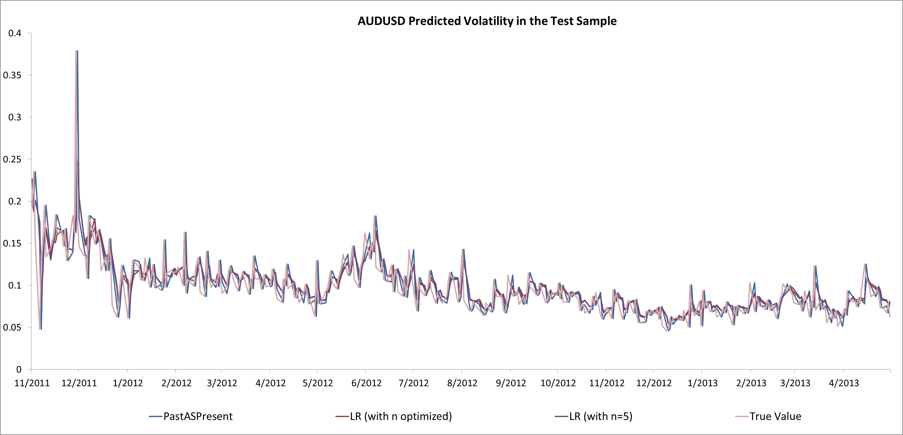
(b) Benchmark Model 2: Linear Regression Model Summary (Linear Regression vs. PastAsPresent)

Slide 42
Agenda
Data Description & Performance Measurement
Introduction to Models Studied
Research Model 1: Ridge Regression Model
Research Model 2: Bayesian Ridge Regression Model
Research Model 3: Kernel Ridge Regression Model
Logic Flow of the Project
Results of Prediction Performance
Benchmark Model 1: PastAsPresent Model
Benchmark Model 2: Linear Regression Model
Research Model 1: Ridge Regression Model
Research Model 2: Bayesian Ridge Regression Model
Research Model 3: Kernel Ridge Regression Model
Further Study

Slide 43
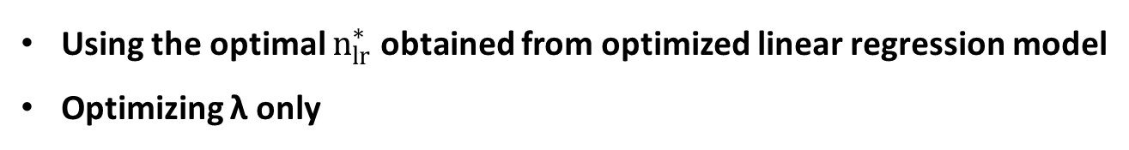
(c) Research Model 1: Ridge Regression Model
Using the optimal $n_{lr}^{∗}$ obtained from optimized linear regression model
Optimizing λ only
Data used to fit the
first model in the
training sample
The first prediction
made in the
training sample
Data used to fit the
first model in the
test sample
The first prediction
made in the
test sample
300
301
T1
T1+1
T2
T₁ is the last datum in the training sample
T₁+1 is the first datum in the test sample
Skip the first 300 data
Training Sample
(first 3.5 years)
Test Sample
(last 1.5 years)
Pick the optimal λ*
Test using the optimal λ*

Slide 44
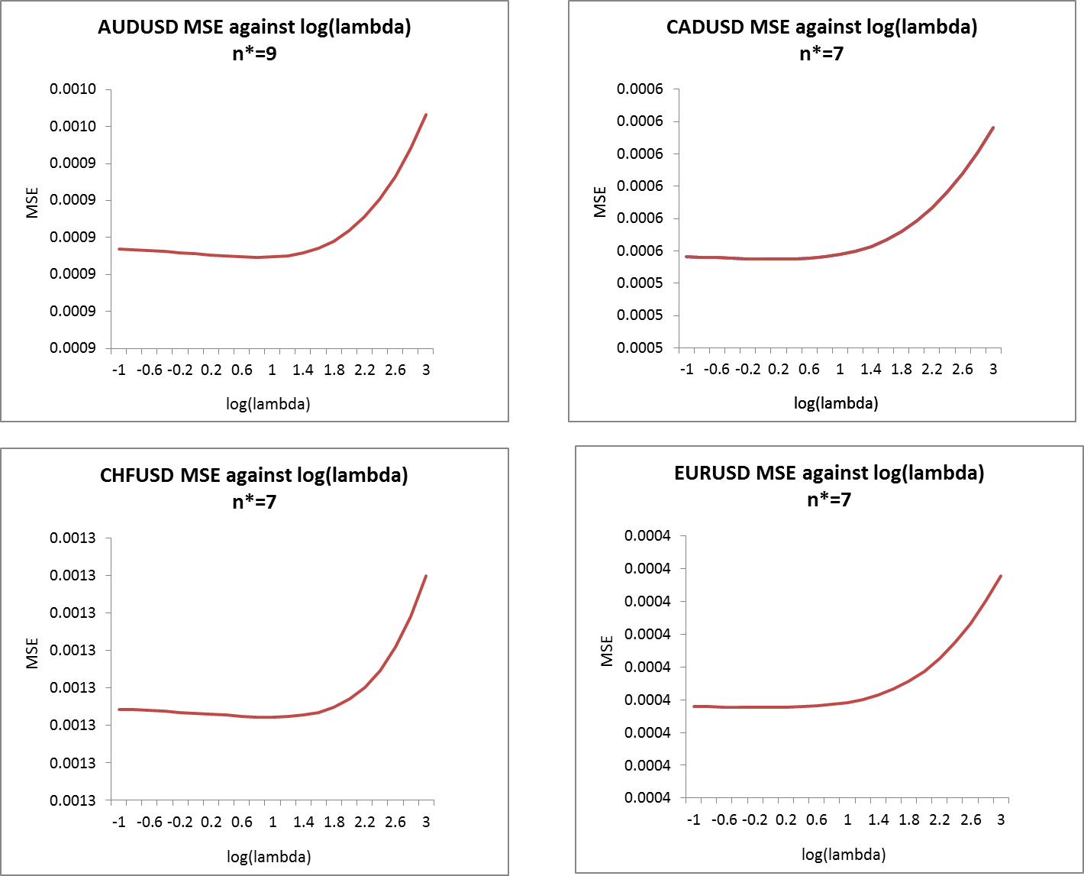
(c) Research Model 1: Ridge Regression Model optimal lambda for Different Currency Pairs (n* from LR)

Slide 45
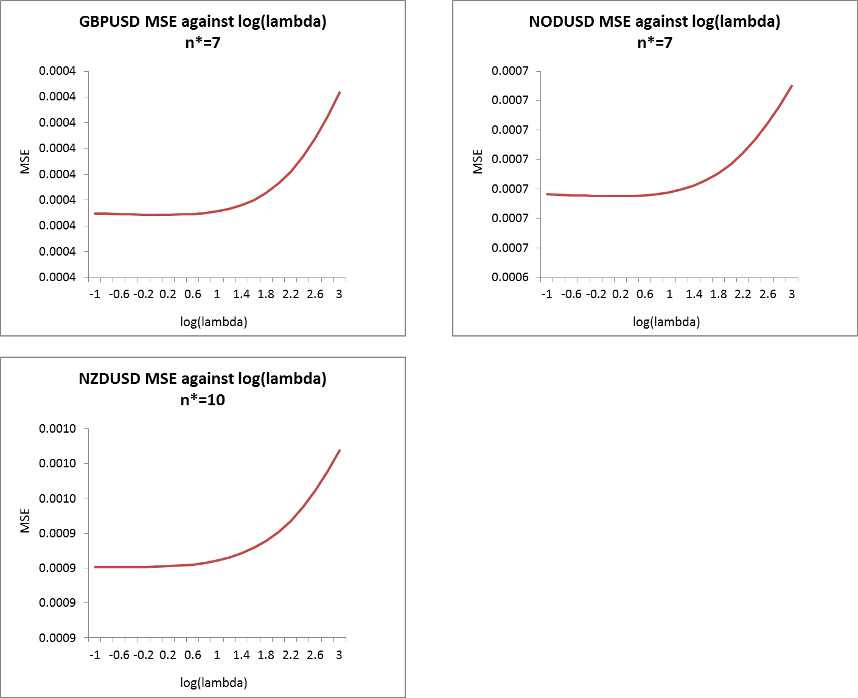
(c) Research Model 1: Ridge Regression Model optimal lambda for Different Currency Pairs (n* from LR)

Slide 46
(c) Research Model 1: Ridge Regression Model Stability of Coefficients (of Best Fitted Model) in the Training Sample
Observation:
For each currency pair, coefficients of the best fitted model (producing the lowest MSE) in the training sample are quite stable over time
During the period when SE is higher, the value of coefficients often have larger changes
For a fixed n, as lambda value increases, fitted parameter (except intercept) values generally decrease
AUDUSD RR(9)
EURUSD RR(7)
NZDUSD RR(10)
CADUSD RR(7)
GBPUSD RR(7)
CHFUSD RR(7)
NOKUSD RR(7)

Slide 47
(c) Research Model 1: Ridge Regression Model vs. Benchmark Model 2: Linear Regression Model
Observation:
Ridge regression model (with the same optimal n* as Linear Regression Model) slightly outperformed Linear Regression Model (with n optimized) in terms of sum of MSE and sum of QL across 7 currency pairs

Slide 48
(c) Research Model 1: Ridge Regression Model What if we optimize both n and lambda?
Ridge Regression 1:
only optimize lambda
Ridge Regression 2:
optimize both n and lambda
Observation:
Degree of Outperformance
(RR1 vs. RR2):
Sum of MSE: 3.40%
Sum of QL: 2.25%
RR1 Model is slightly better than RR2 Model

Slide 49
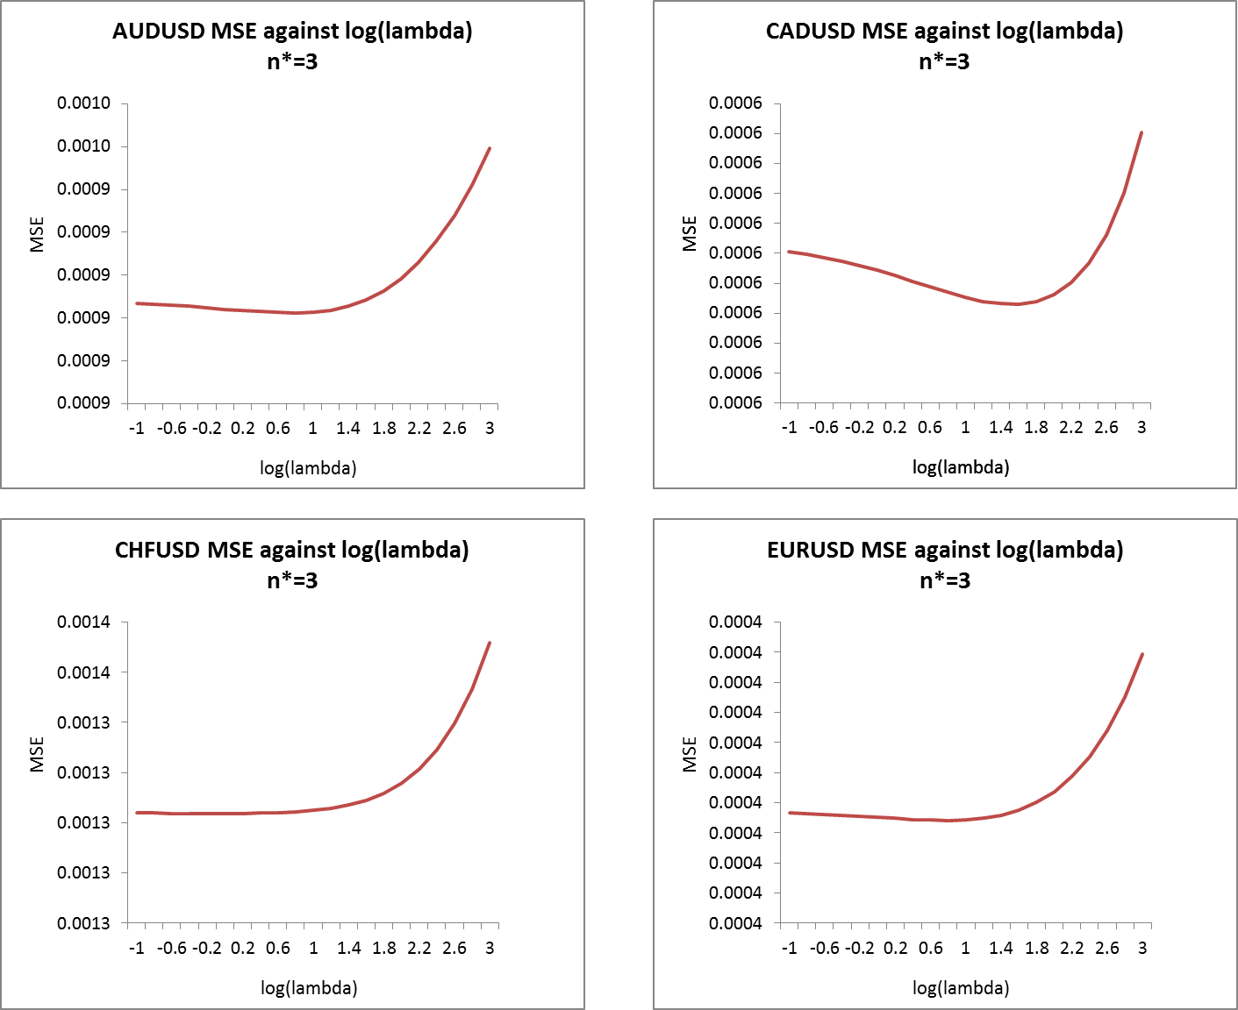
(c) Research Model 1: Ridge Regression Model What if we use n = 3 for all currency pairs?

Slide 50
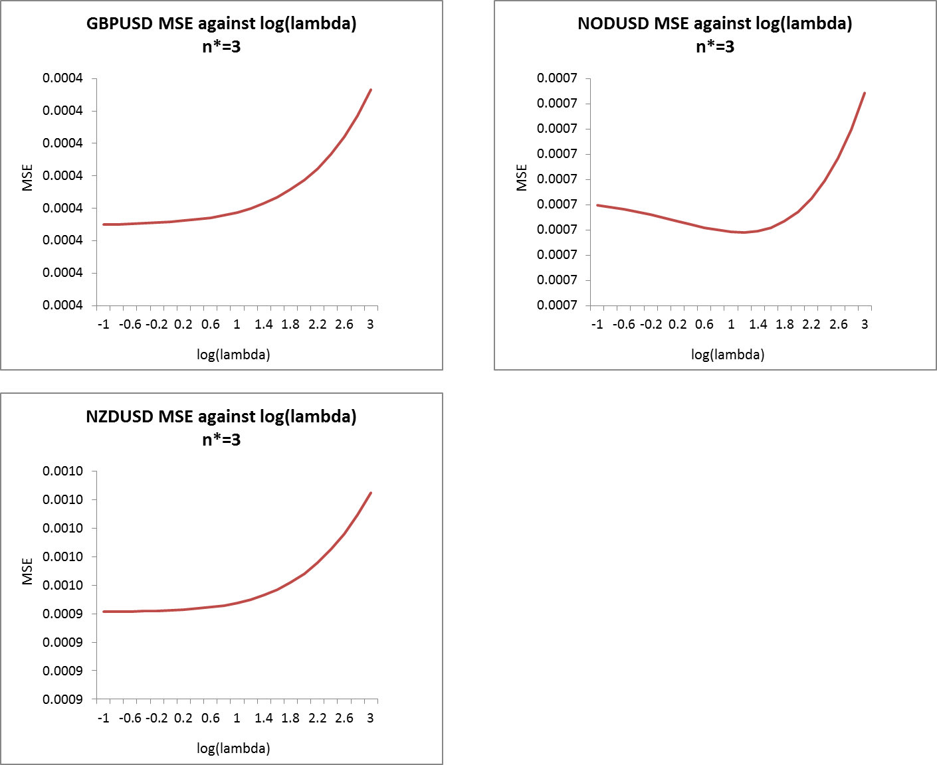
(c) Research Model 1: Ridge Regression Model What if we use n = 3 for all currency pairs?

Slide 51
(c) Research Model 1: Ridge Regression Model What if we use n = 3 for all currency pairs?
Observation:
Decreasing the number of optimal parameters does not improve prediction performance in terms of sum of MSE & sum of QL in the test sample.
Degree of Outperformance
(different optimal n*
vs. n=3 for all ):
Sum of MSE: 11.06%
Sum of QL: 10.08%
A lot? Maybe…

Slide 52
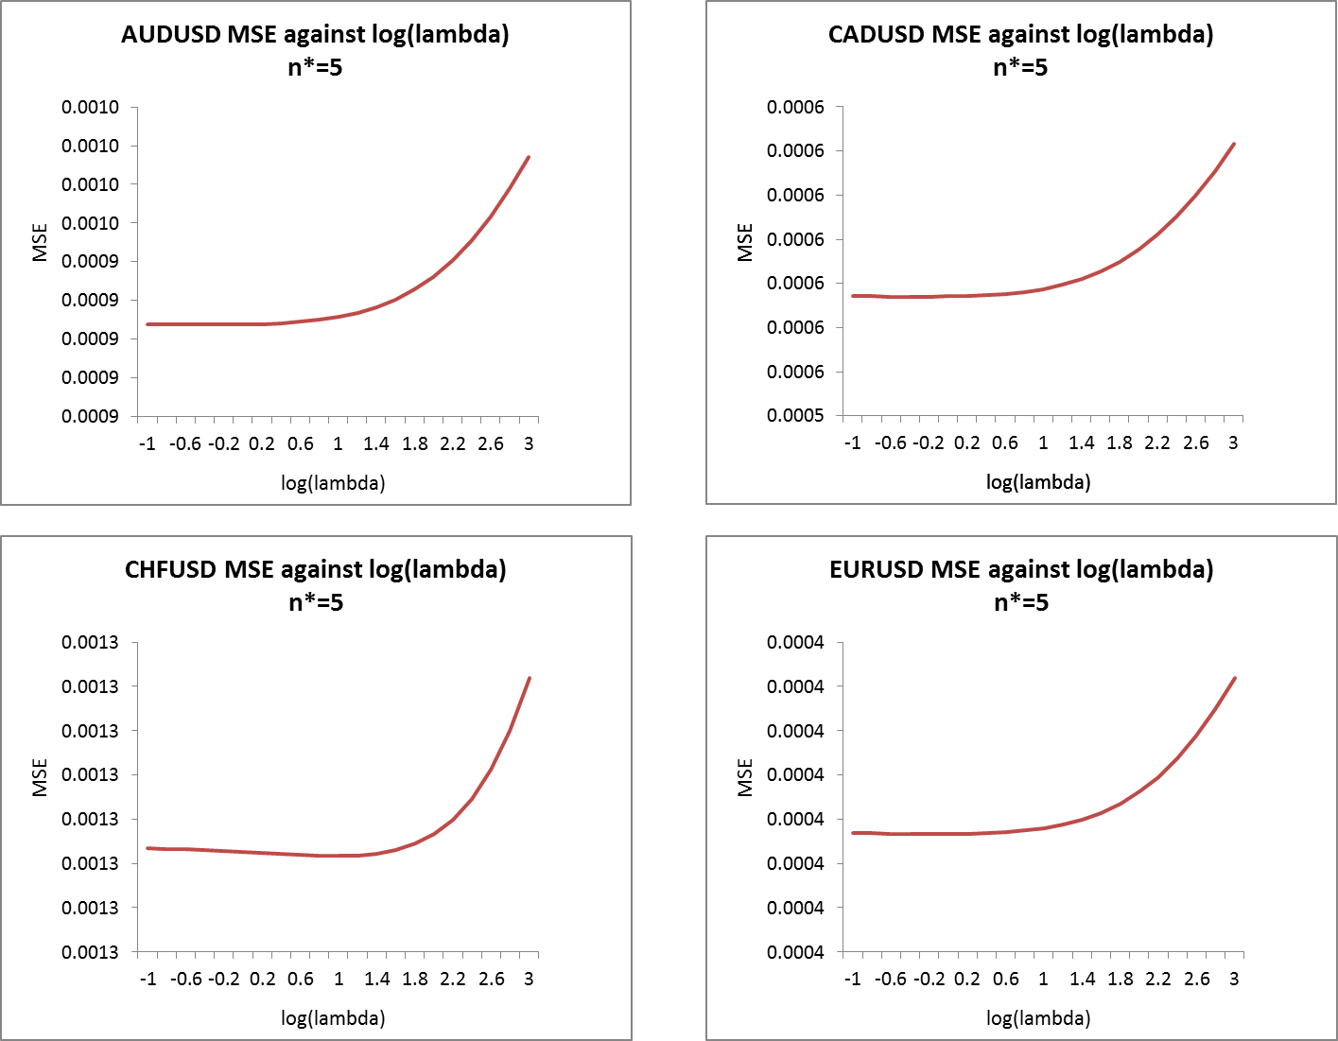
(c) Research Model 1: Ridge Regression Model What if we use n = 5 for all currency pairs?

Slide 53
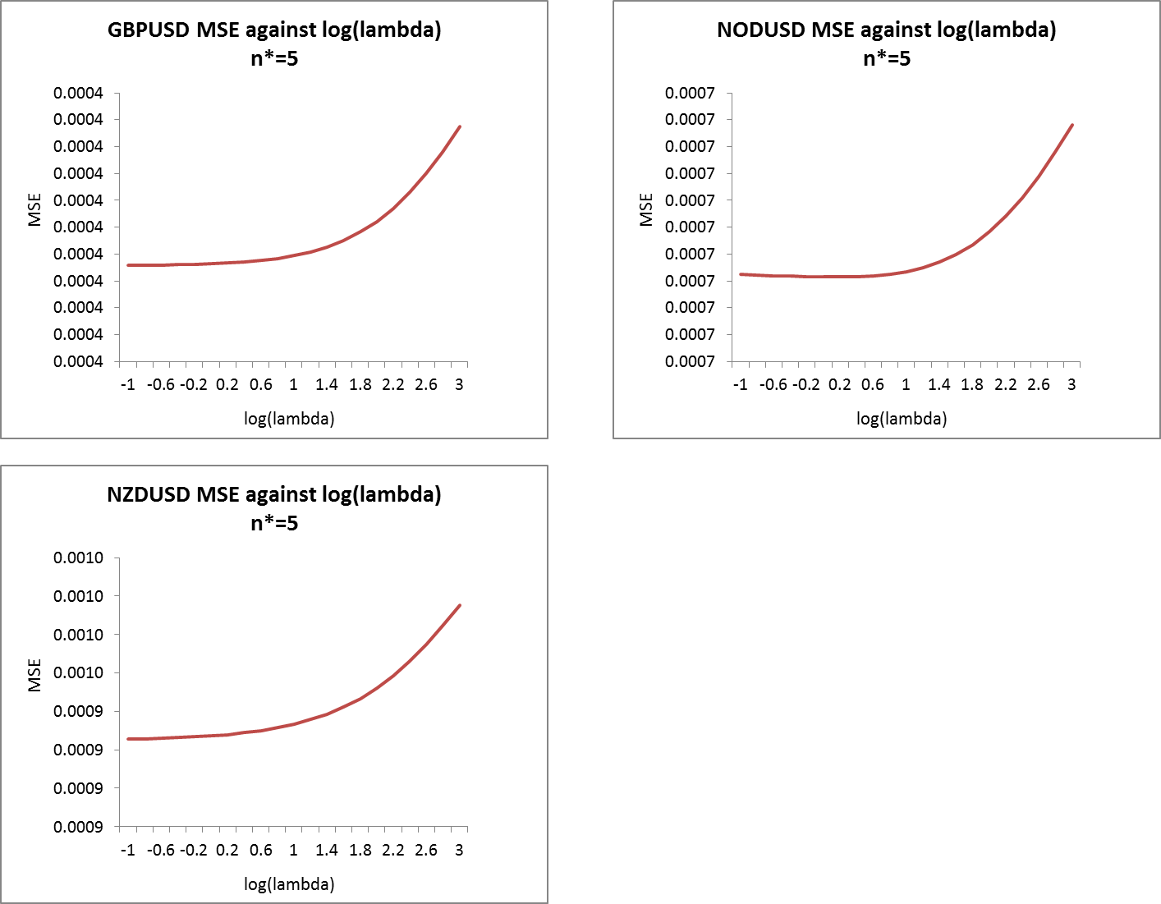
(c) Research Model 1: Ridge Regression Model What if we use n = 5 for all currency pairs?

Slide 54
(c) Research Model 1: Ridge Regression Model What if we use n = 5 for all currency pairs?
Observation:
Degree of Outperformance
(different optimal n*
vs. n=5 for all):
Sum of MSE: 2.06%
Sum of QL: 1.63%
Pretty small…
Thus,
for ridge regression, we may want to use n=5 for all currency pairs
- Consistency across all currency pairs.

Slide 55
(c) Research Model 1: Ridge Regression Model What if we use n = 5 for all currency pairs and set lambda = 1 (default)?
Observation:
Degree of Outperformance
n=5 and lambda = 1 (default)
vs.
n=5 and lambda optimized
Sum of MSE: 0.13%
Sum of QL: 0.15%
Thus,
for ridge regression, we may want to use n=5 and lambda=1 for all currency pairs
- Consistency across all currency pairs.

Slide 56
(c) Research Model 1: Ridge Regression Model Summary (Ridge Regression vs. Linear Regression & PastAsPresent)

Slide 57
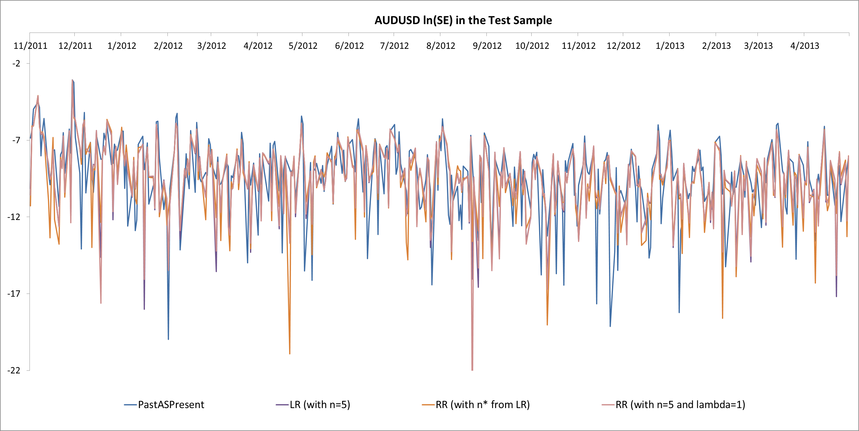
(c) Research Model 1: Ridge Regression Model Summary (Ridge Regression vs. Linear Regression & PastAsPresent)

Slide 58
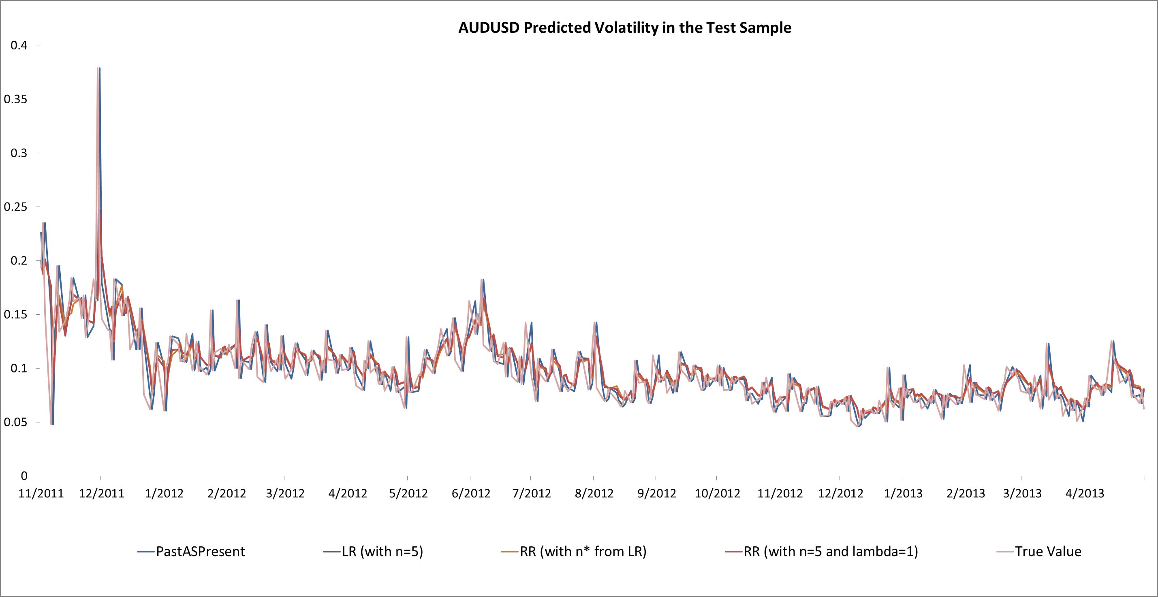
(c) Research Model 1: Ridge Regression Model Summary (Ridge Regression vs. Linear Regression & PastAsPresent)

Slide 59
Agenda
Data Description & Performance Measurement
Introduction to Models Studied
Research Model 1: Ridge Regression Model
Research Model 2: Bayesian Ridge Regression Model
Research Model 3: Kernel Ridge Regression Model
Logic Flow of the Project
Results of Prediction Performance
Benchmark Model 1: PastAsPresent Model
Benchmark Model 2: Linear Regression Model
Research Model 1: Ridge Regression Model
Research Model 2: Bayesian Ridge Regression Model
Research Model 3: Kernel Ridge Regression Model
Further Study

Slide 60
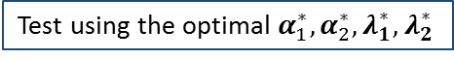
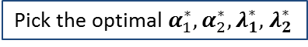
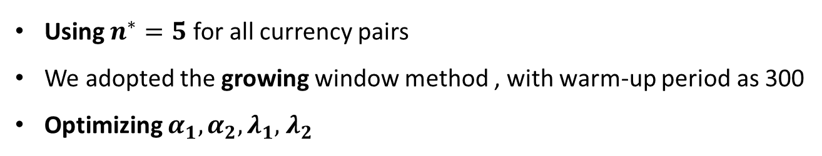
(d) Research Model 2: Bayesian Ridge Regression Model
Using $n_{}^{∗}=5$ for all currency pairs
We adopted the growing window method , with warm-up period as 300
Optimizing $α_{1},α_{2}, λ_{1},$ $λ_{2}$
Data used to fit the
first model in the
training sample
The first prediction
made in the
training sample
Data used to fit the
first model in the
test sample
The first prediction
made in the
test sample
300
301
T1
T1+1
T2
T₁ is the last datum in the training sample
T₁+1 is the first datum in the test sample
Skip the first 300 data
Training Sample
(first 3.5 years)
Test Sample
(last 1.5 years)
Pick the optimal $α_{1}^{∗},α_{2}^{∗}, λ_{1}^{∗},$ $λ_{2}^{∗}$
Test using the optimal $α_{1}^{∗},α_{2}^{∗}, λ_{1}^{∗},$ $λ_{2}^{∗}$

Slide 61
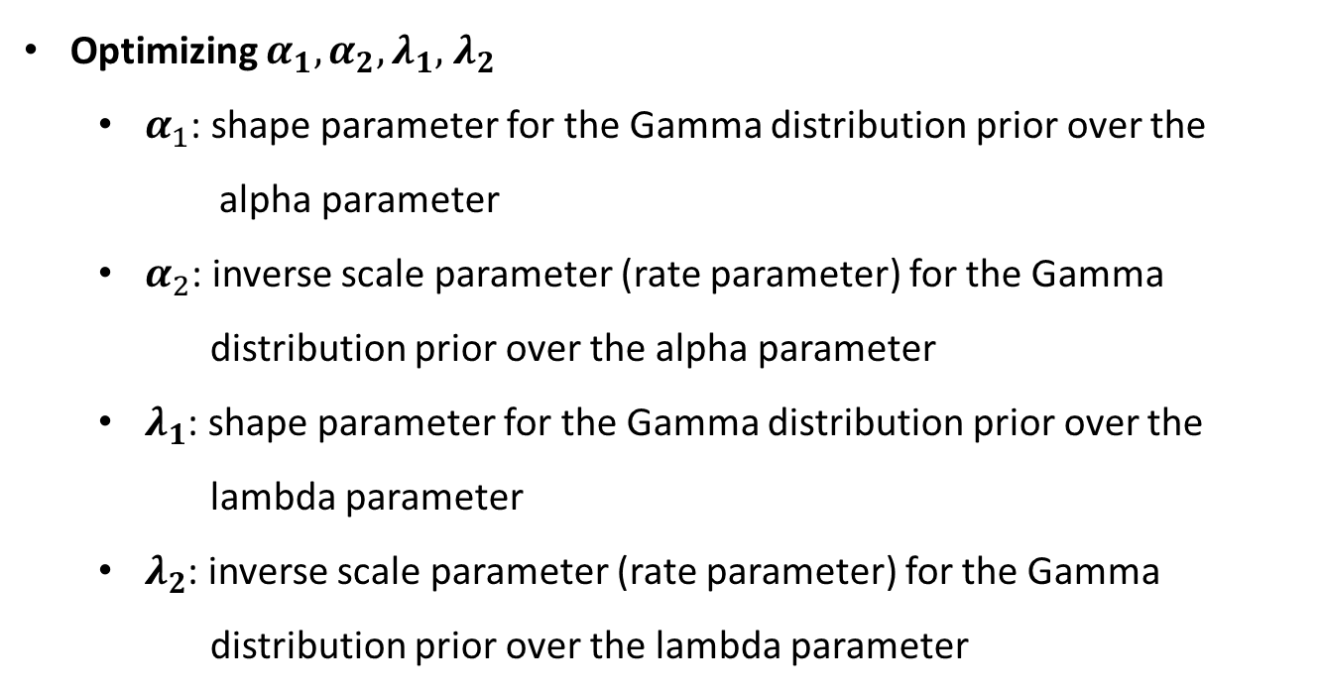
(d) Research Model 2: Bayesian Ridge Regression Model
Optimizing $α_{1},α_{2}, λ_{1},$ $λ_{2}$
$α_{1}$: shape parameter for the Gamma distribution prior over the alpha parameter
$α_{2}$: inverse scale parameter (rate parameter) for the Gamma distribution prior over the alpha parameter
$λ_{1}$: shape parameter for the Gamma distribution prior over the lambda parameter
$λ_{2}$: inverse scale parameter (rate parameter) for the Gamma distribution prior over the lambda parameter

Slide 62
(d) Research Model 2: Bayesian Ridge Regression Model (with n=5 and all 4 hyper-parameters optimized) vs. Research Model 1: Ridge Regression Model
Observation:
Bayesian ridge regression model (with n=5 and all 4 hyper-parameters optimized) slightly underperformed Ridge Regression Model (with n=5) in terms of sum of MSE and sum of QL

Slide 63
(d) Research Model 2: Bayesian Ridge Regression Model (with n=5 and all hyper-parameters taking the same value) vs. Research Model 1: Ridge Regression Model
Observation:
Bayesian ridge regression model (with n=5 and all hyper-parameters taking the default value 10^(-6)) slightly underperformed Ridge Regression Model (with n=5 and lambda=1) in terms of sum of MSE and sum of QL

Slide 64
(d) Research Model 2: Bayesian Ridge Regression Model (with n=5 and all hyper-parameters taking the same value) summary vs. two Benchmark Models & Research Model 1
In a previous slide:
Compared with the OLS estimator, Bayesian ridge regression is a more stable model.
Bayesian ridge regression is more robust to ill-posed problem.

Slide 65
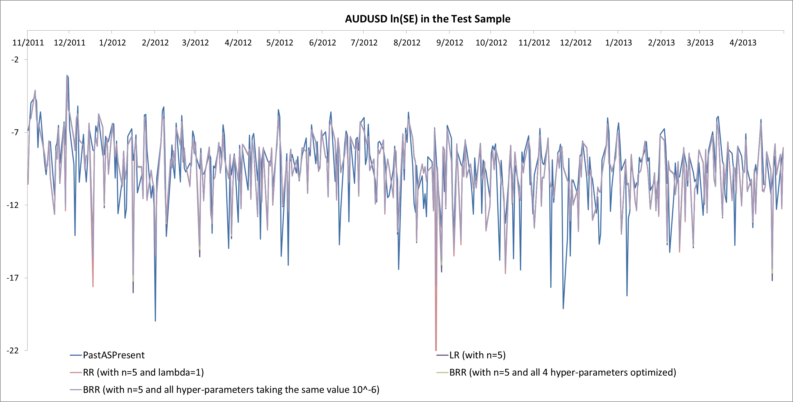
(d) Research Model 2: Bayesian Ridge Regression Model (with n=5 and all hyper-parameters taking the same value) summary vs. two Benchmark Models & Research Model 1

Slide 66
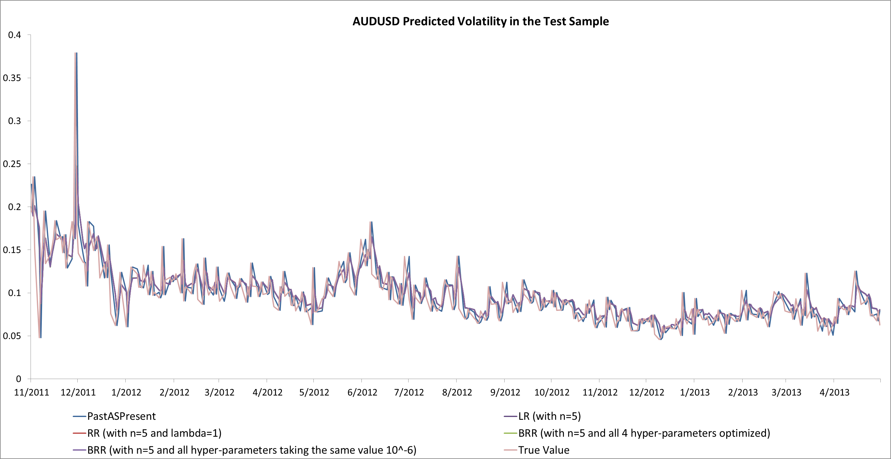
(d) Research Model 2: Bayesian Ridge Regression Model (with n=5 and all hyper-parameters taking the same value) summary vs. two Benchmark Models & Research Model 1

Slide 67
Agenda
Data Description & Performance Measurement
Introduction to Models Studied
Research Model 1: Ridge Regression Model
Research Model 2: Bayesian Ridge Regression Model
Research Model 3: Kernel Ridge Regression Model
Logic Flow of the Project
Results of Prediction Performance
Benchmark Model 1: PastAsPresent Model
Benchmark Model 2: Linear Regression Model
Research Model 1: Ridge Regression Model
Research Model 2: Bayesian Ridge Regression Model
Research Model 3: Kernel Ridge Regression Model
Further Study

Slide 68
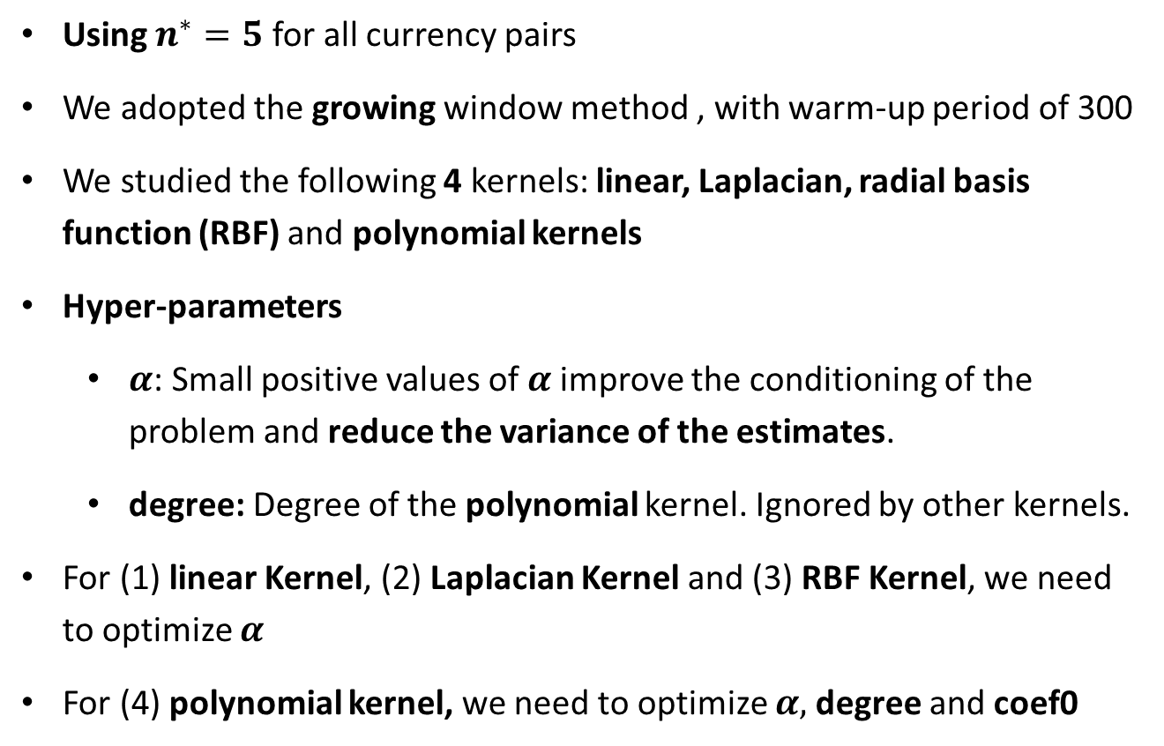
(e) Research Model 3: Kernel Ridge Regression Model
Using $n_{}^{∗}=5$ for all currency pairs
We adopted the growing window method , with warm-up period of 300
We studied the following 4 kernels: linear, Laplacian, radial basis function (RBF) and polynomial kernels
Hyper-parameters
$α$: Small positive values of $α$improve the conditioning of the problem and reduce the variance of the estimates.
degree: Degree of the polynomial kernel. Ignored by other kernels.
For (1) linear Kernel, (2) Laplacian Kernel and (3) RBF Kernel, we need to optimize $α$
For (4) polynomial kernel, we need to optimize $α,$degree and coef0

Slide 69
(e) Research Model 3: Kernel Ridge Regression Model

Slide 70
Summary of All Models (including two benchmark models & three research models)
Observation:
Kernel ridge regression model (with linear kernel, n=5 and alpha taking the default value 1) slightly outperformed Ridge Regression Model (with n=5) in terms of sum of MSE and sum of QL

Slide 71
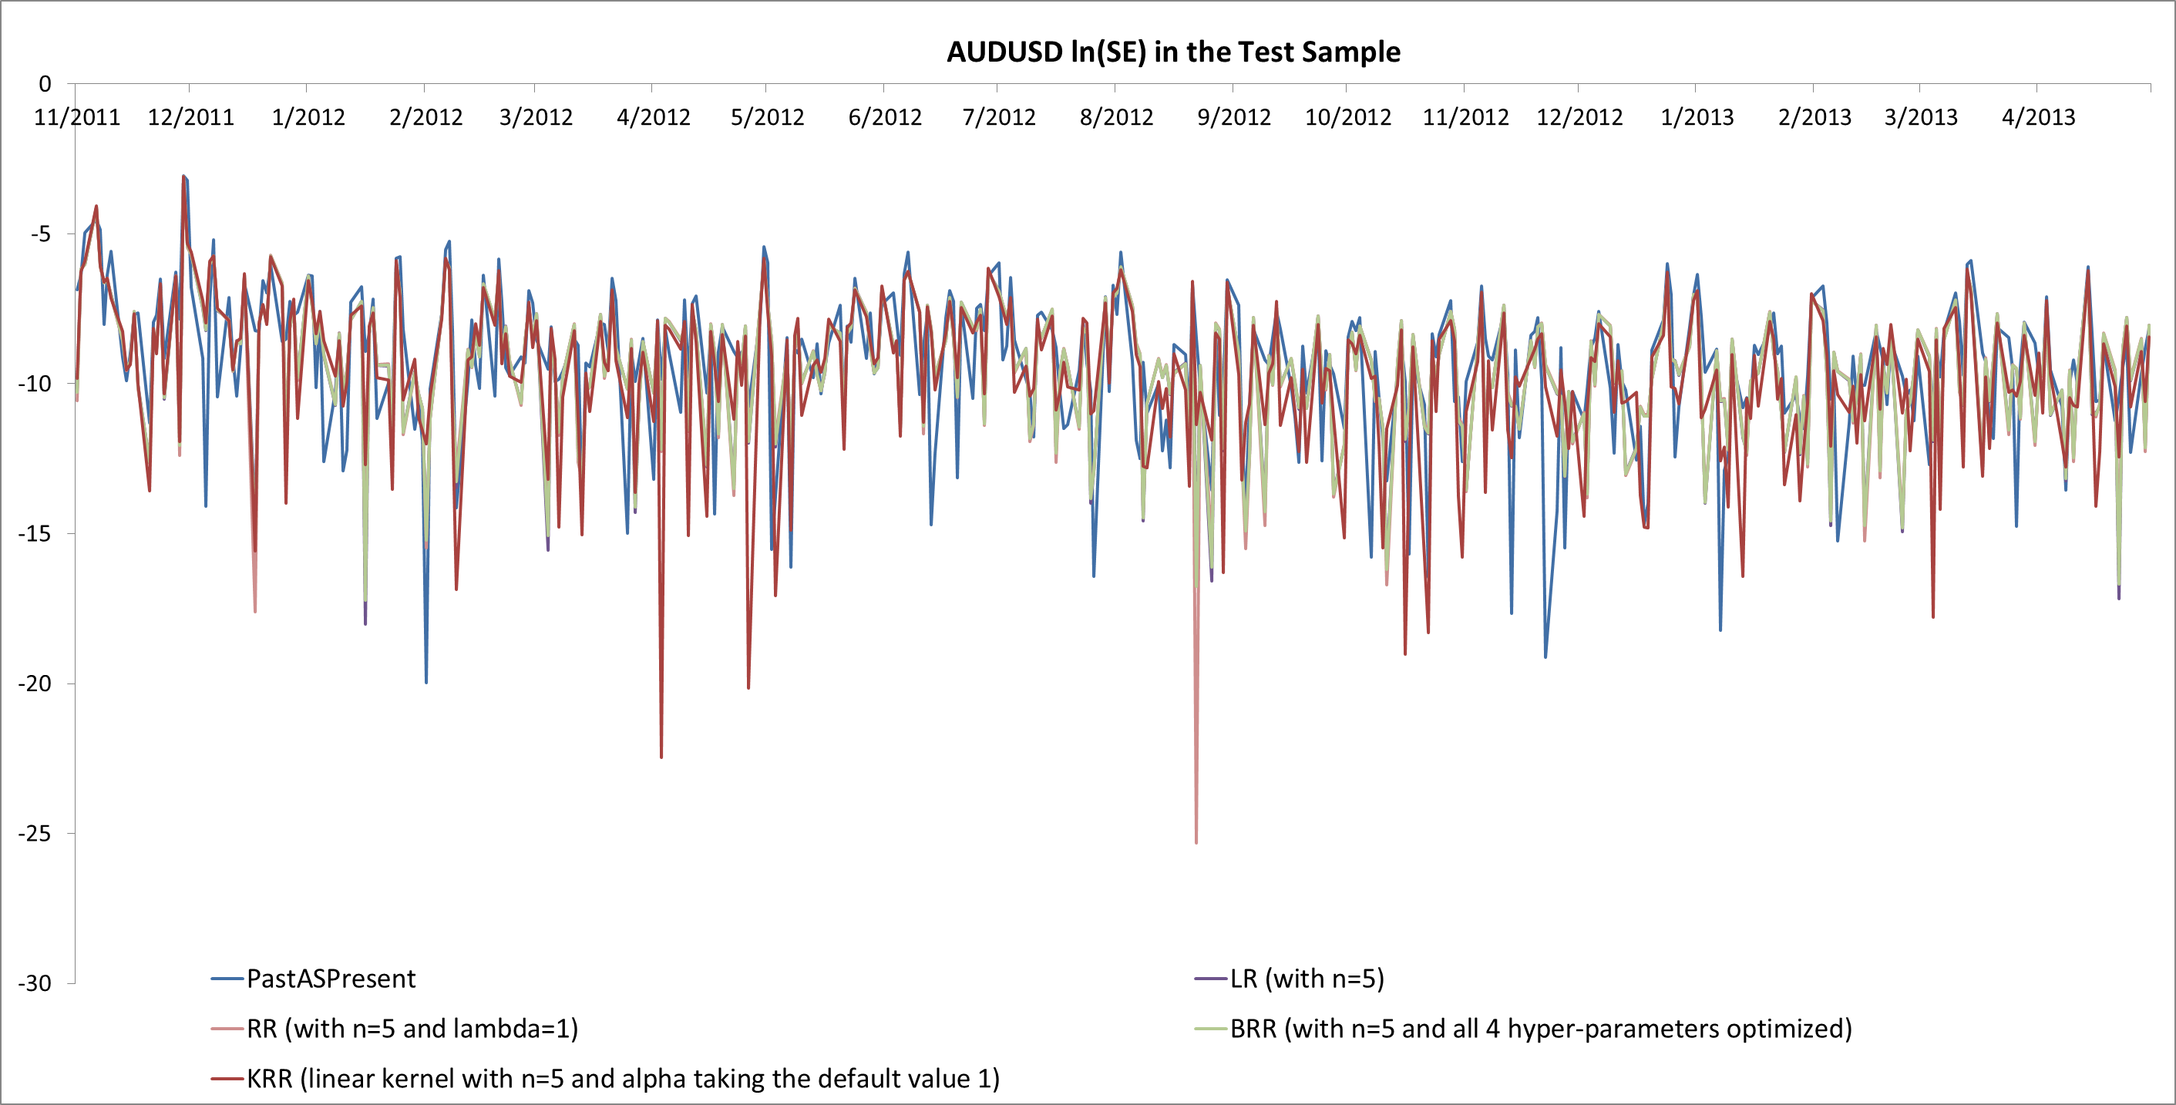
(e) Research Model 3: Kernel Ridge Regression Model summary vs. two Benchmark Models & Research Model 1 & 2

Slide 72
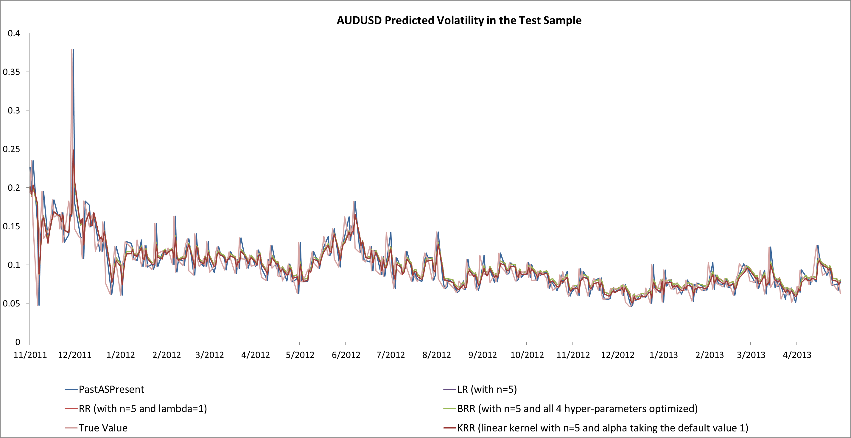
(e) Research Model 3: Kernel Ridge Regression Model summary vs. two Benchmark Models & Research Model 1 & 2

Slide 73
Agenda
Data Description & Performance Measurement
Introduction to Models Studied
Research Model 1: Ridge Regression Model
Research Model 2: Bayesian Ridge Regression Model
Research Model 3: Kernel Ridge Regression Model
Logic Flow of the Project
Results of Prediction Performance
Benchmark Model 1: PastAsPresent Model
Benchmark Model 2: Linear Regression Model
Research Model 1: Ridge Regression Model
Research Model 2: Bayesian Ridge Regression Model
Research Model 3: Kernel Ridge Regression Model
Further Study

Slide 74
Fitting One Model for All Currency Pairs – Daily Volatility & log Volatility: highly correlated

Slide 75
(new b) Fitting One Linear Regression Model for All Currency Pairs through Standardization (using optimal n*)
Observation:
Linear regression model_new (with n optimized) slightly outperformed Linear regression model_old (with n optimized) in terms of sum of MSE and sum of QL

Slide 76
(new b) Fitting One Linear Regression Model for All Currency Pairs through Standardization (using n=3)
Observation:
Linear regression model_new (with n=3) slightly outperformed Linear regression model_old (with n=3) in terms of sum of MSE and sum of QL

Slide 77
(new b) Fitting One Linear Regression Model for All Currency Pairs through Standardization (using n=5)
Observation:
Linear regression model_new (with n=5) slightly outperformed Linear regression model_old (with n=5) in terms of sum of MSE and sum of QL

Slide 78
(new b) Fitting One Linear Regression Model for All Currency Pairs through Standardization Summary
Observation:
Linear regression model_new (with n=5) seems to be the most suitable model in terms of sum of MSE, sum of QL and the level of model complexity

Slide 79
(new c) Fitting One Ridge Regression Model for All Currency Pairs through Standardization (using n=3 with lambda optimized)
Observation:
Ridge regression model_new (with n=3 and alpha optimized) slightly outperformed Ridge regression model_old (with n=3 and alpha optimized) in terms of sum of MSE and sum of QL

Slide 80
(new c) Fitting One Ridge Regression Model for All Currency Pairs through Standardization (using n=5 with lambda optimized)
Observation:
Ridge regression model_new (with n=5 and alpha optimized) slightly outperformed Ridge regression model_old (with n=5 and alpha optimized) in terms of sum of MSE and sum of QL

Slide 81
(new c) Fitting One Ridge Regression Model for All Currency Pairs through Standardization (using n=5 and lambda=1 (default))
Observation:
Ridge regression model_new (with n=5 and alpha=1) slightly outperformed Ridge regression model_old (with n=5 and alpha=1) in terms of sum of MSE and sum of QL

Slide 82
(new c) Fitting One Ridge Regression Model for All Currency Pairs through Standardization Summary

Slide 83
(new d) Fitting One Bayesian Ridge Regression Model for All Currency Pairs through Standardization (using n=5 and all four hyper-parameters taking the default value 10^(-6))
Observation:
Bayesian ridge regression model_new (with n=5 and all hyper-paramers=10^(-6)) slightly outperformed Bayesian ridge regression model_old (with n=5 and all hyper-paramers=10^(-6)) in terms of sum of MSE and sum of QL

Slide 84
(new d) Fitting One Bayesian Ridge Regression Model for All Currency Pairs through Standardization Summary
Observation:
Bayesian ridge regression model_new (with n=5 and all hyper-paramers=10^(-6)) slightly underperformed ridge regression model_new (with n=5 and apha=1), but outperformed linear regression model and PastAsPresent model in terms of sum of MSE and sum of QL

Slide 85
(new e) Fitting One Kernel Ridge Regression Model for All Currency Pairs through Standardization (using n=5, linear kernel)
Observation:
Kernel ridge regression model_new (linear Kernel with n=5 and the alpha hyper-parameter taking the default value 1) slightly outperformed the comparative Kernel ridge regression model_old (linear kernel, n=5, alpha=1) in terms of sum of MSE and sum of QL

Slide 86
(new e) Fitting One Kernel Ridge Regression Model for All Currency Pairs through Standardization (using n=5, polynomial kernel)
Observation:
Kernel ridge regression model_new (polynomial Kernel with n=5 and the other hyper-parameters taking default value: alpha=1, coef0=1 & degree=3) slightly outperformed the comparative Kernel ridge regression model_old with polynomial kernel in terms of sum of MSE and sum of QL

Slide 87
(new e) Fitting One Kernel Ridge Regression Model for All Currency Pairs through Standardization Summary
Observation:
Linear Kernel ridge regression model slightly outperformed the polynomial Kernel ridge regression model in terms of sum of MSE and sum of QL
Kernel ridge regression model_new (linear Kernel with n=5 and alpha=1) slightly outperformed the comparative Kernel ridge regression model_old (linear Kernel with n=5 and alpha=1) in terms of sum of MSE and sum of QL

Slide 88
Summary of All Models (including two benchmark models & three research models)
Observation:
Ridge Regression Model (n=5, alpha=1) seems to be the best model if we use the new method
Kernel Ridge Regression Model (n=5, linear kernel, alpha=1) seems to be the best model if we use the old method

Slide 89
Summary of All Models (including two benchmark models & three research models)
Observation:
The new method where one single model is fitted for all currency pairs through standardization generally outperformed the old method where one model is fitted for each currency pair

Slide 90
Lists of Reference
Documentation on http://scikit-learn.org
“Machine Learning: A Probabilistic Perspective” Murphy, K. P., The MIT Press, 2012

